Slide 1

Content and Collaborative based Sinhala Book Recommendation System
Chinthaka Perera
19440677 / 2019/MCS/067
Supervised by:
Prof. M.G.N.A.S. Fernando

Slide 2
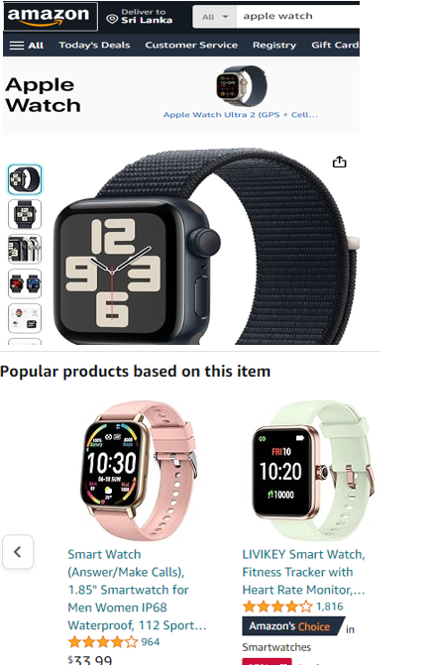
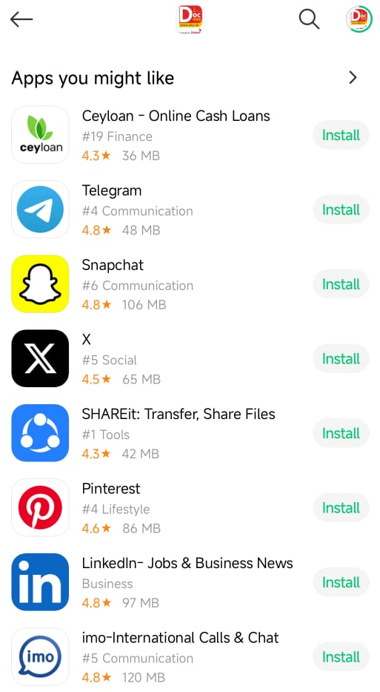
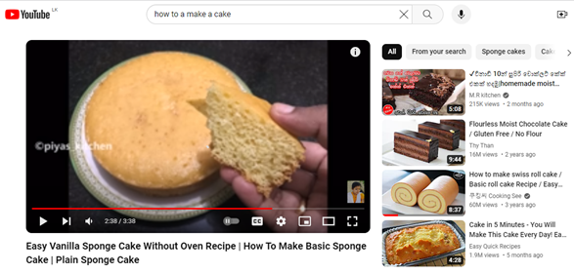
Recommendation systems
A recommendation system is a computer program that recommends items for users of digital platforms such as e-commerce websites and social networks

Slide 3
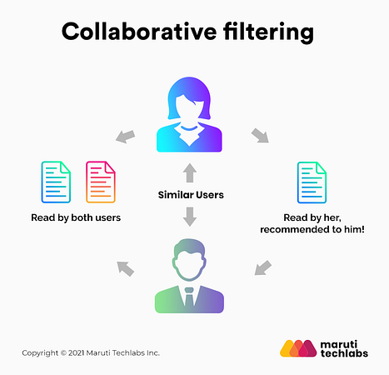
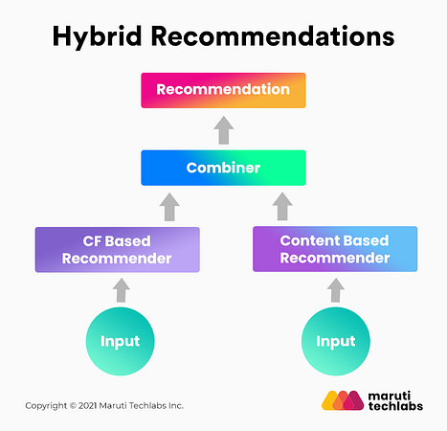
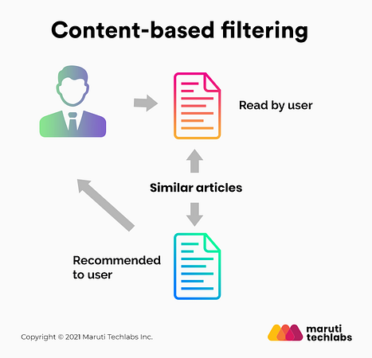
Types of Recommendation systems
Collaboration Filter
Content Based Filter
Knowledge based
Demographic based
Hybrid Filter

Slide 4






Problem statement

Slide 5
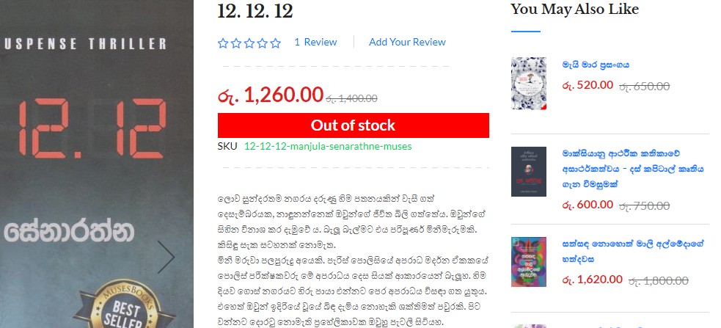
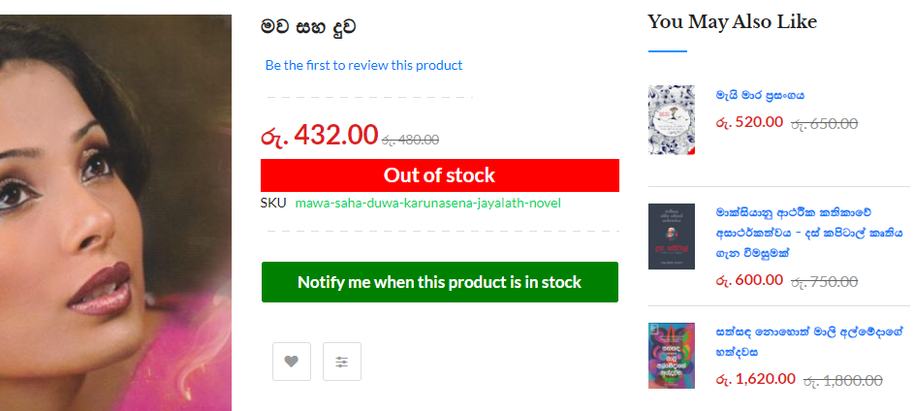
Research gap
Multiple application for English Book Recommendation
Online book store limitations

Slide 6
Scope of the study
Share a Google form
Apply sentiment analysis for the reviews
Login and register to the application
Display a book details when a book is selected
List out recommended book list for the selected book

Slide 7
Research questions
How to find a valid dataset.
How to apply sentiment analysis with high accurate for the review.
What are the preprocessing steps to be carried out.
How to apply Collaborative based approach and content based approach (hybrid).
How to recommend list of books with highest accuracy.
How to evaluate the system.

Slide 8
Literature works
Research | Description | Technology | Limitation
Personalized Book Recommendation System using Machine Learning Algorithm - 2021 (Sarma et al., 2021) | It recommend books for online users that rated a book using the clustering method and then found a similarity of that book to suggest a new book | Clustering based approach that use collaborative, content based, hybrid. | Less Accuracy
Book Recommendation Platform using Deep Learning - 2020 (Wadikar et al., 2020) | It recommend books based on two approaches. Text based and image based | Cosine Similarity and Convolutional Neural Network (CNN) | evaluation and validation process have not been presented in the research

Slide 9
Literature works
Research | Description | Technology | Limitation
Book Recommendation System using Item based Collaborative Filtering - 2019 (Shah, 2019) | It describes all the recommendation problems like sparsity, cold start in details and used item based approach to implement the system. And Mean Absolute Error (MAE) used for evaluation | Item based collaboration approach | User reviews has not been used for recommendation
An Enhanced Collaborative Filtering-based Approach for Recommender Systems – 2020 (Sallam et al., 2020) | A system implemented for Arabic dataset. | Item based and model based via Matrix Factorization | User reviews data (Arabic) has not been considered for recommendation

Slide 10
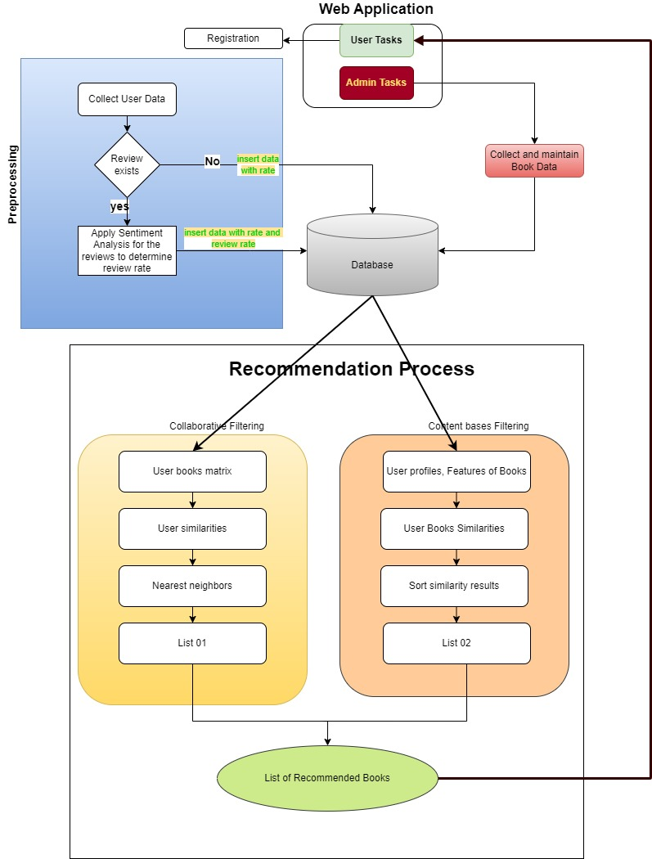


architecture
Preprocessing
Apply Collaborative filtering
Apply Content based filtering
Combined the result with hybrid approach

Slide 11
Design
User Interface
Login/logout with authenticate
View most rated book list
View most popular book list
Search particular book
Display he details of the selected book
Display some reviews and rate given by users for the selected book
List out 20 recommended books
Backend logic
Python with libraries
Database
Mysql - workbench

Slide 12
implementation
User Interface
Implement the UI with python flask, Bootstrap, html and css
Integrate authentication
Pre processing
Google Translator to convert Sinhala review to English
Apply sentiment analysis – TextBlob, Vader, Own mechanism
Main Technology
Apply Collaborate Filter
Apply Content based filter
Apply Hybrid by combining Collaborate and Content based

Slide 13
Evaluation
Qualitative
To evaluate the novelty, scope of the proposed application
To evaluate whether the system provides a solution to the existing problem
To identify the limitations of the project
Quantitative
System
Collaborative via Mean Absolute Error (MAE) –> 2.52
Content via Artificial Neural Network (ANN) → 80%
Online

Slide 14
Future enhancement
Collect more data to enhance the accuracy.
Display the dropdown book list in Sinhala fonts in data collection form.
Consider latest books.
Include a book purchase facility by routing to an online book store.
Include more filters like genre
Include more details of a book like number of pages, published year, ISBM number

Slide 15
challenges
To collect a data set
Implementation
Evaluation

Slide 16
limitations
The books published after 2022 were considered.
Admin functionalities has not been integrated
Age range has not been considered for recommendation.

Slide 17
demo
Sinhala Book Recommendation System

Slide 18
Thank you

